Slide 1
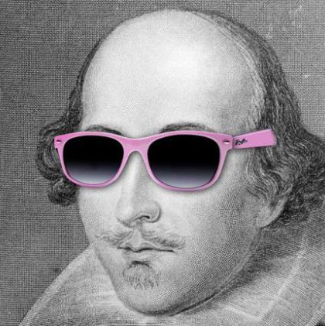
Symbolism
It’s cool, right?
What do we know about it?

Slide 2
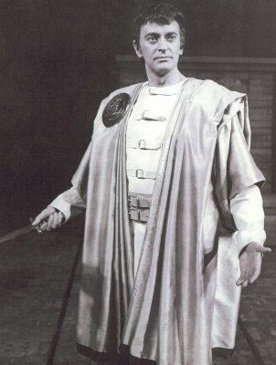
What are examples that you can find in the play?
Let’s talk about them.

Slide 3
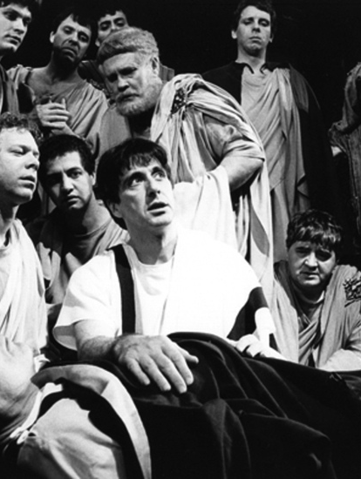
Make a list of at least 3 strong symbols that Shakespeare uses and why they are significant.
Be prepared to add one to the chart and discuss with class.

Slide 4
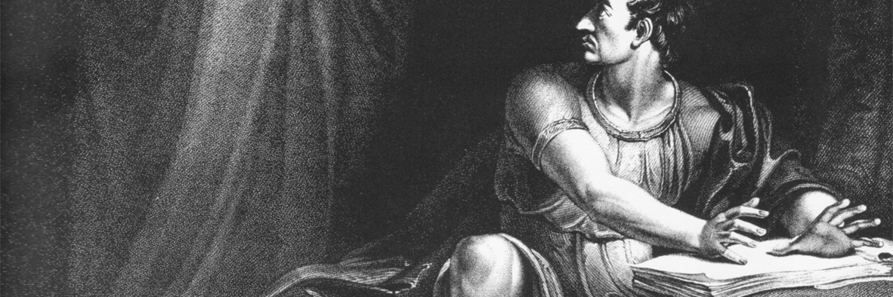
Drawing Activity
Take out a piece of paper.
Take about a minute or so to draw me what you think would be a symbolic picture that describes Brutus’ soliloquy.
Once you are done, be prepared to answer some questions about what you drew.

Slide 5
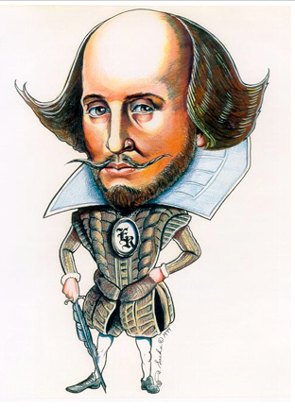
Drawing Questions:
What does your picture show?
2. What is one important idea that your picture shows?
3. What are two specific details included in your picture?
4. What is something that you would like to emphasize about your picture?

